Slide 1


Department of Computer Science and Engineering
Blended Ensemble Learning for Demand Prediction: An AutoML Driven Approach
Dr. Senthil Pandi S
Team ID:B21A2425C22
Mohamed Hussain (210701161)
Nathaniel Abishek (210701173)

Slide 2
Problem Statement and Motivation
Manual Model Selection & Tuning:
Selecting and fine-tuning machine learning models manually is time-consuming and requires expertise.
Suboptimal tuning leads to lower prediction accuracy and inefficient demand forecasting.
Limited Automation in Demand Forecasting:
Traditional forecasting techniques lack automation, requiring extensive human intervention.
AutoML adoption is still limited in real-world demand prediction scenarios.
Need for Improved Prediction Accuracy:
Traditional models often fail to generalize across different industries and market conditions.
Ensemble learning can enhance accuracy but is underutilized in automated forecasting.
Enhancing Forecasting Efficiency:
Automating demand prediction reduces manual effort and speeds up decision-making.
Leveraging AutoML for Smarter Predictions:
Using AutoML ensures optimal model selection, hyperparameter tuning, and better generalization.

Slide 3
Objectives
Automate Demand Forecasting: Integrate AutoML to handle model selection, hyperparameter tuning, and data preprocessing.
Create an End-to-End AutoML Framework: Design a fully automated framework that streamlines data preprocessing, model selection, hyperparameter tuning, and evaluation.
Minimize Human Intervention: Simplify the process, reducing the need for domain expertise and manual configuration.
Enhance Operational Efficiency: Deliver faster, more reliable demand predictions for inventory and supply chain optimization.

Slide 4
Abstract
In this study, we enhance demand forecasting by leveraging AutoML with ensemble learning. While our previous approach relied on AutoML to select a single best model, this extended work identifies the top five models and ensembles the best three to improve prediction accuracy. We also integrate Natural Language Processing (NLP) to allow users to dynamically query the dataset for demand insights. The solution features a user-friendly web interface developed using Streamlit (frontend) and Flask (backend). Results show that our ensemble model significantly outperforms traditional single-model methods. By customizing AutoML to include industry-specific data patterns and variables, we further boost its effectiveness. Overall, this project showcases a powerful, scalable, and intelligent solution for real-world demand forecasting by combining advanced ML techniques with an intuitive interface.

Slide 5
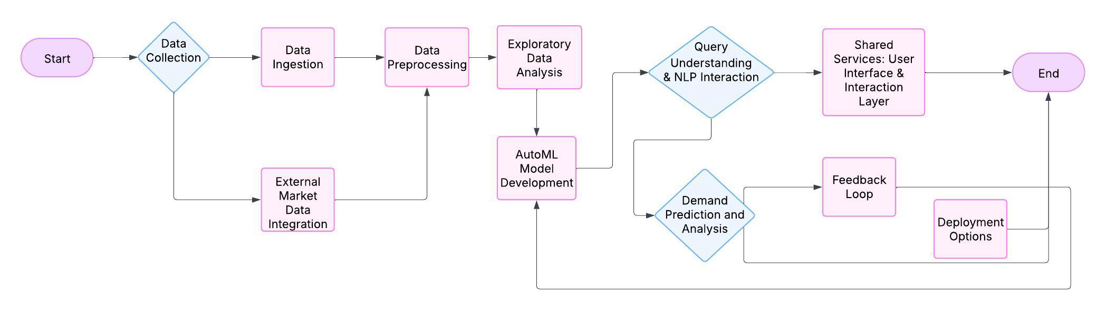
System Architecture

Slide 6
List of Modules
Data Collection and Cleaning
Exploratory Data Analysis
Feature Engineering
AutoML Model Selection and Ensembling
Model Evaluation
Web Application Integration
Reporting and Visualization

Slide 7
Functional Description for Data collection & Cleaning
Data Ingestion: User uploads data set through the UI
Data Validation: Verify data consistency by checking for duplicates, missing values, and inconsistencies.
Data Cleaning: Remove errors, handle null values, and standardize formats.
Preprocessing: Transform raw data into structured formats suitable for analysis, including normalization and feature extraction.

Slide 8
Functional Description for Exploratory Data Analysis
Descriptive Statistics: Summarize data using mean, median, variance, and distributions to understand trends and patterns.
Data Visualization: Use graphs and charts like histograms and scatterplots to explore relationships and outliers.
Correlation Analysis: Identify relationships between variables to select impactful features.
Data Insights: Detect anomalies, trends, and potential challenges for informed preprocessing and modeling decisions.

Slide 9
Functional Description for Feature Engineering
Feature Selection: Identify the most relevant features from the dataset using techniques like correlation and mutual information.
Feature Transformation: Normalize, scale, or encode data to ensure compatibility with machine learning algorithms.
Dimensionality Reduction: Simplify datasets using techniques like PCA to remove redundant or irrelevant features while retaining essential information.

Slide 10
Functional Description for AutoML model selection and Ensembling
Model Selection: Automatically evaluate multiple algorithms to identify the best-performing models based on accuracy, precision, or other metrics.
Hyperparameter Tuning: Optimize model parameters automatically to enhance performance and reduce overfitting.
Ensembling Techniques: Combine top models using methods like bagging, boosting, or stacking to improve robustness and accuracy.

Slide 11
Functional Description for Model Evaluation
Performance Metrics: Evaluate models using metrics like RMSE, MAE, accuracy, precision, recall, and F1-score to assess prediction quality.
Validation Techniques: Use cross-validation and train-test splits to ensure the model generalizes well to unseen data.
Comparative Analysis: Compare model performance to baseline methods and select the most reliable approach for deployment.

Slide 12
Functional Description for Web Application Integration
Frontend Integration: Uses an intuitive UI for users to upload datasets, configure options, and view demand predictions.
Backend Connectivity: Connect the web application to the prediction system and carry the models using Flask.
Scalability: Ensure the web application supports multiple users and large datasets while maintaining performance and reliability.

Slide 13
Functional Description for Reporting and Visualization
Trend Analysis: Visualize historical and forecasted demand patterns for better decision-making.
Export Options: Provide downloadable formats like PDF or Excel for sharing and offline analysis of results.
Interactive Dashboards: Create dynamic dashboards to display predictions, trends, and key insights using graphs, charts, and tables.

Slide 14
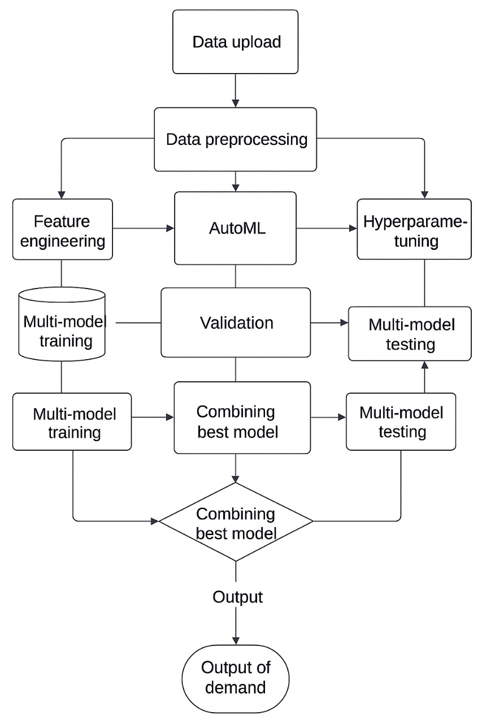
Data Flow Diagram

Slide 15
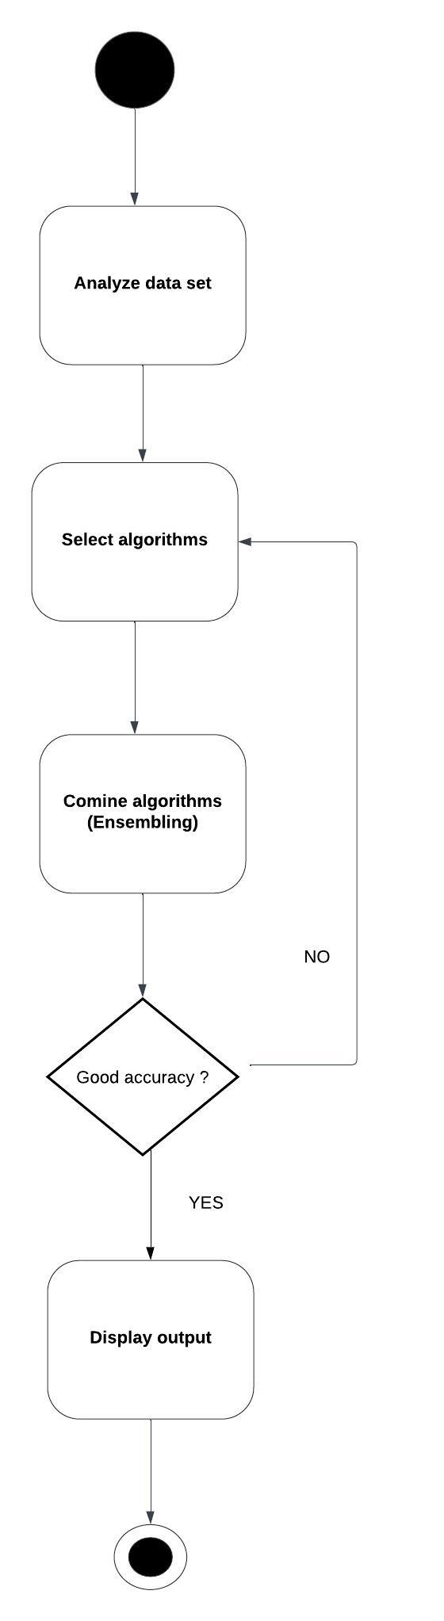
Functional Description for each modules with DFD and Activity Diagram

Slide 16
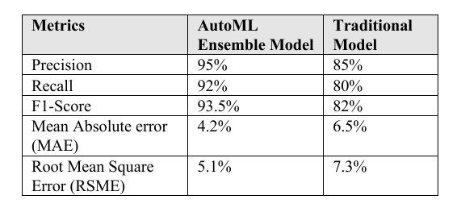
Implementation & Results of Module
The AutoML-generated ensemble models are expected to deliver an accuracy of around 90-95% for short-term demand forecasts and 85-90% for longer-term predictions. In cases involving seasonal or highly volatile product categories, the system still maintains an accuracy of approximately 80-85%, outperforming many traditional models.

Slide 17
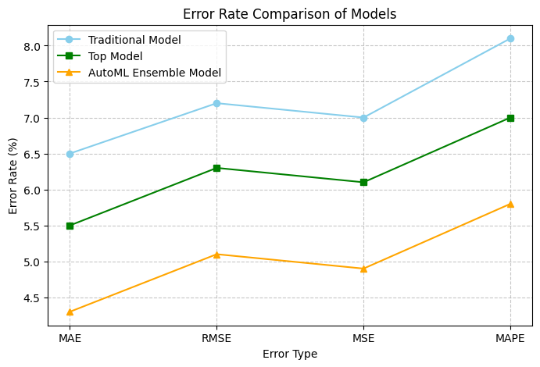
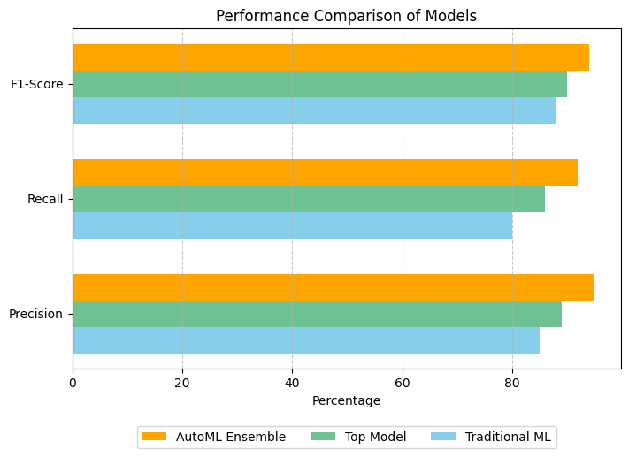
Implementation & Results of Module

Slide 18
Conclusion
In this study, we presented a demand forecasting approach using AutoML-based ensemble learning with NLP-driven query interactions in a web system. By combining traditional models with modern ensemble techniques, our system significantly improved forecasting accuracy.
Performance: The ensemble model outperformed traditional models like Linear Regression, Decision Tree, and Random Forest, as well as advanced models like XGBoost, LightGBM, and CatBoost.
Metrics: It showed lower MAE and MSE, with a high R² score. The approach also performed better than AutoML tools like Auto-sklearn and H2O AutoML, offering a cost-effective alternative to commercial solutions like Google AutoML.

Slide 19
References
[1] S. Mhatre, S. Patil, N. Mishra, V. Mungelwar and H. Patil, "AutoML Based Tourism Prediction and Maximising Revenue," 2024 2nd International Conference on Sustainable Computing and Smart Systems (ICSCSS), Coimbatore, India, 2024, pp. 1193-1202,doi: 10.1109/ICSCSS60660.2024.10625466.
[2] T. Nagarajah and G. Poravi, "A Review on Automated Machine Learning (AutoML) Systems," 2019 IEEE 5th International Conference for Convergence in Technology (I2CT), Bombay, India, 2019, pp. 1-6, doi: 10.1109/I2CT45611.2019.9033810.
[3] Q. Lyu and R. Zhang, "Research on Demand Forecasting Method of Shared Bicycle Based on Ensemble Learning," 2023 International Conference on Image Processing, Computer Vision and Machine Learning (ICICML), Chengdu, China, 2023, pp. 861-865,doi: 10.1109/ICICML60161.2023.10424944.
[4] D. Mallikarachchi, D. Rathnayake, D. Abegunawardana, S. Van-Hoff, D. Kasthurirathna and A. Gamage, "Automated Machine Learning for Prediction of Type 2 Diabetes and Its Major Complications: A Comparative Study," 2023 5th International Conference on Advancements in Computing (ICAC), Colombo, Sri Lanka, 2023, pp. 466-471, doi: 10.1109/ICAC60630.2023.10417572.

Slide 20
References
[5] A. Ghareeb, H. Al-bayaty, Q. Haseeb and M. Zeinalabideen, "Ensemble learning models for short-term electricity demand forecasting," 2020 International Conference on Data Analytics for Business and Industry: Way Towards a Sustainable Economy (ICDABI), Sakheer, Bahrain, 2020, pp. 1-5, doi: 10.1109/ 2020.9325623.
[6] Y. Jin, X. Ye, Q. Ye, T. Wang, J. Cheng and X. Yan, "Demand Forecasting of Online Car-Hailing With Stacking Ensemble Learning Approach and Large Scale Datasets," in IEEE Access, vol. 8, pp. 199513-199522, 2020, doi: 10.1109/ACCESS.2020.3034355.
[7] V. E. Kovalevsky and N. A. Zhukova, "Building a Model for Time Series Forecasting using AutoML Methods," 2024 XXVII International Conference on Soft Computing and Measurements (SCM), Saint Petersburg, Russian Federation, 2024, pp. 308-311, doi: 10.1109/SCM62608.2024.10554133.
[8] H. -A. -D. Cap, T. -H. Do, D. S. Lakew and S. Cho, "Building a Time-Series Forecast Model with Automated Machine Learning for Heart Rate Forecasting Problem," 2022 13th International Conference on Information and Communication Technology Convergence (ICTC), Jeju Island, Korea, Republic of, 2022, pp. 1097-1100, doi: 10.1109/ICTC55196.2022.9952797.

Slide 21
References
[9] I. Met, A. Erkoç and S. E. Seker, "Performance, Efficiency, and Target Setting for Bank Branches: Time Series With Automated Machine Learning," in IEEE Access, vol. 11, pp. 1000-1010, 2023,doi: 10.1109/ACCESS.2022.3233529.
[10] G. Stamatescu, R. Plamanescu and M. Albu, "Leveraging Anomaly Detection and AutoML for Modelling Residential Measurement Power Traces," 2023 IEEE 13th International Workshop on Applied Measurements for Power Systems (AMPS), Bern, Switzerland, 2023, pp. 1-5, doi: 10.1109/AMPS59207.2023.10297201.
[11] H. Iftikhar, S. Mancha Gonzales, J. Zywiołek and J. L. López-Gonzales, "Electricity Demand Forecasting Using a Novel Time Series Ensemble Technique," in IEEE Access, vol. 12, pp. 88963-88975, 2024,doi: 10.1109/ACCESS.2024.3419551.
[12] P. Kumar, U. L. Maneesh and G. Mano Sanjay (2024), "Optimizing Loan Approval Decisions: Harnessing Ensemble Learning for Credit Scoring," 2024 International Conference on Advances in Computing, Communication and Applied Informatics (ACCAI), Chennai, India, 2024, pp. 1-4, doi: 10.1109/ACCAI61061.2024.10602097.

Slide 22
References
[13] Y. Zhang, H. Zhu, Y. Wang and T. Li, "Demand Forecasting: From Machine Learning to Ensemble Learning," 2022 IEEE Conference on Telecommunications, Optics and Computer Science (TOCS), Dalian, China, 2022, pp. 461-466, doi: 10.1109/TOCS56154.2022.10015992.
[14] D. Hulak and G. Taylor, "Investigating an Ensemble of ARIMA Models for Accurate Short-Term Electricity Demand Forecasting," 2023 58th International Universities Power Engineering Conference (UPEC), Dublin, Ireland, 2023, pp. 1-6, doi: 10.1109/UPEC57427.2023.10294946.
[15] P. Naik, M. Dalponte and L. Bruzzone, "Automated Machine Learning Driven Stacked Ensemble Modeling for Forest Aboveground Biomass Prediction Using Multitemporal Sentinel-2 Data," in IEEE Journal of Selected Topics in Applied Earth Observations and Remote Sensing, vol. 16, pp. 3442-3454, 2023, doi: 10.1109/JSTARS.2022.3232583.
[16] A. Garg and A. Chaudhary, "Analysis of IPL Auction Dataset Using Explainable Machine Learning with Lime and H2O AutoML," 2023 4th International Conference on Intelligent Engineering and Management (ICIEM), London, United Kingdom, 2023, pp. 1-4, doi: 10.1109/ICIEM59.2023.10167124.

Slide 23
Phase-I Paper Publication Details
TITLE : DEMAND PREDICTION USING AUTOML BASED ENSEMBLE ALGORITHM
AUTHORS: Senthil Pandi S, Kumar P, Nathaniel Abishek A, Mohamed Hussain S
CONFERENCE: International Conference on Artificial Intelligence and Data Engineering –AIDE 2025
MODE OF SUBMISSION: OFFLINE
STATUS: PRESENTED IN THE CONFERENCE

Slide 24
Phase-II Paper Publication Details
TITLE : BLENDED ENSEMBLE LEARNING FOR DEMAND PREDICTION: AN AUTOML DRIVEN APPROACH
AUTHORS: Senthil Pandi S, Kumar P, Nathaniel Abishek A, Mohamed Hussain S
CONFERENCE: International Conference on Circuit, Power and Computing Technologies (ICCPCT-2025)
MODE OF SUBMISSION:OFFLINE
STATUS: ACCEPTED

Slide 25
Thank You

